Slide 1
What did the Maritime Colonies want?
Maritime Leaders:
  Charles Tupper- Nova Scotia
  Leonard Tilley- New Brunswick
  John Hamilton Grey- PEI
Maritime leaders were scared of the American invasion
They considered making a Maritime Union

Slide 2
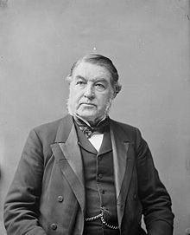
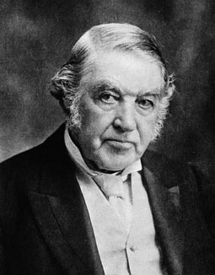
Charles Tupper-NS

Slide 3
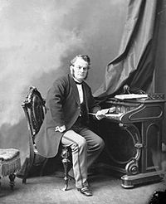
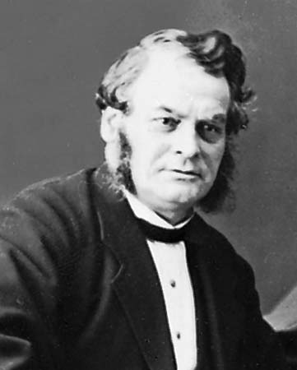
Leonard Tilley-NB

Slide 4
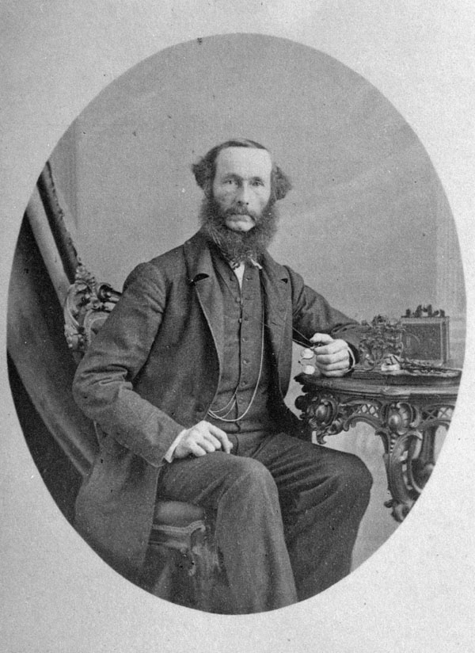
John Hamilton Grey- PEI

Slide 5
Conferences (meetings) that led to confederation
Charlottetown Conference (Sept 1864)
2nd step towards Confederation
Goal: Maritimes joining Canada(s)
Discussions:
  New railway needed
Résultat: Principle of Union with Canada(s) accepted

Slide 6
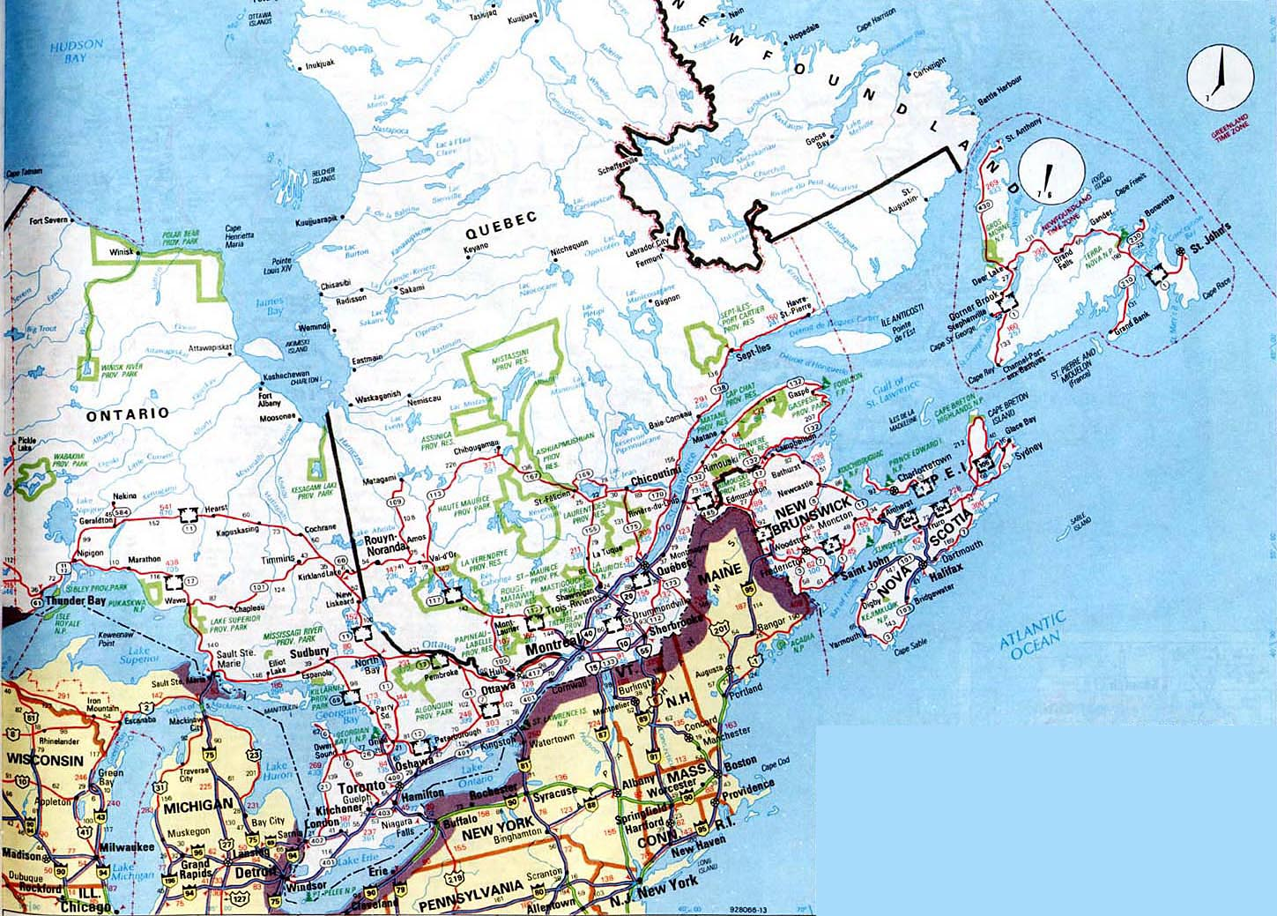
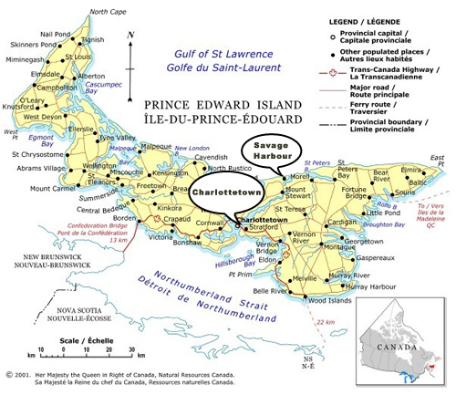
Charlottetown (Sept 1864)

Slide 7
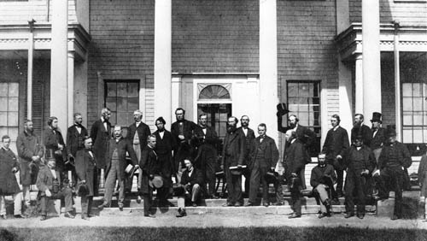
Charlottetown Conference (Sept 1864)

Slide 8
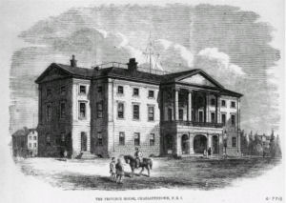
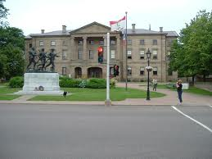
Charlottetown (Sept 1864)
‘Province House’: site of the conference

Slide 9
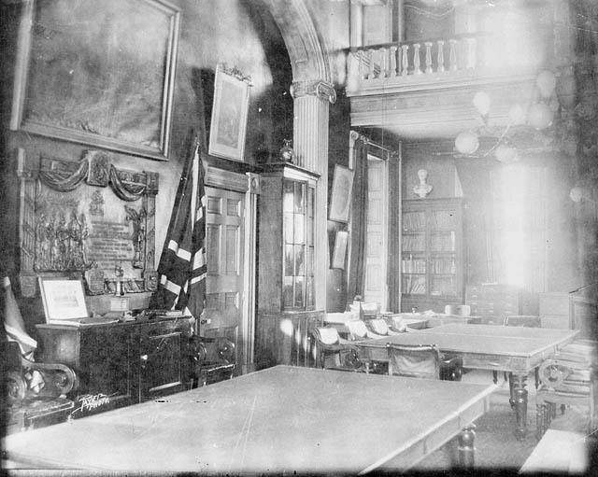
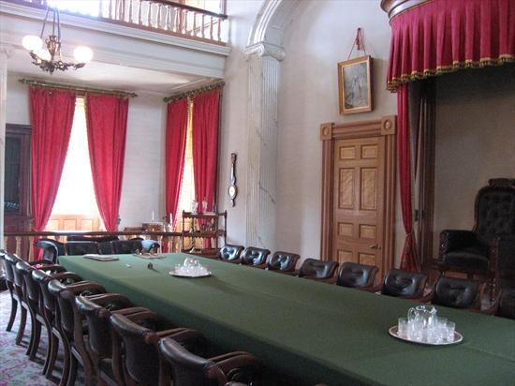
‘Province House’: site of the conference

Slide 10
2. Québec Conference (Oct. 1864)
3rd step towards Confederation
But: Seal the deal of confederation
Discussions:
  Rep by pop!
  Do the Maritimes benefit from Confederation= railway
Result: 72 resolutions written

Slide 11
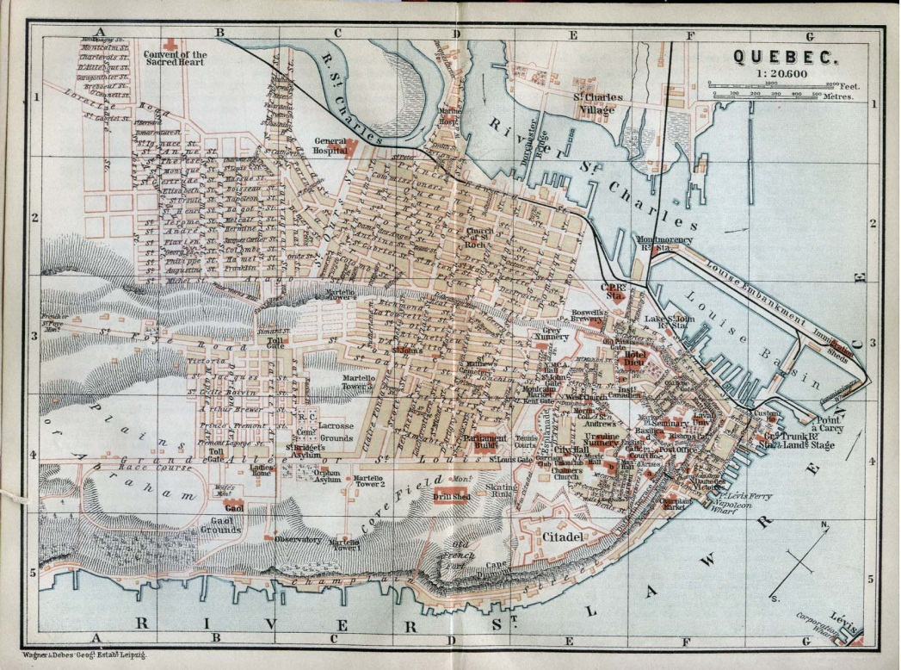
Québec Conference (Oct. 1864)

Slide 12
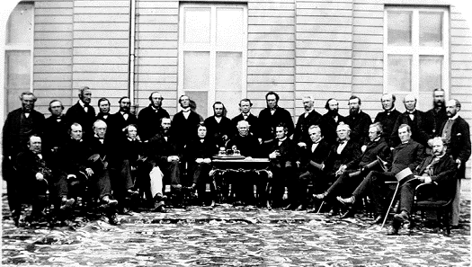
Quebec Conference (Oct. 1864)

Slide 13
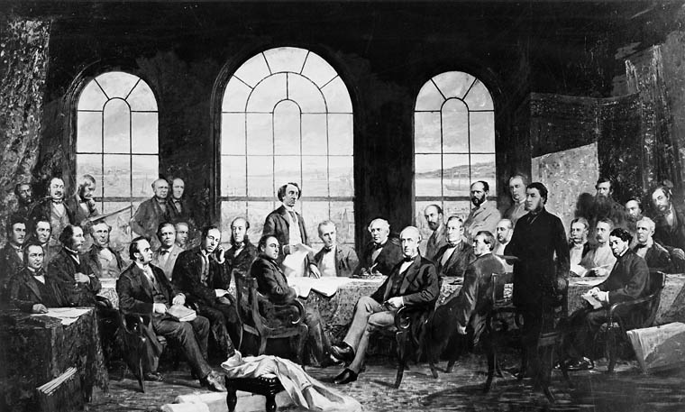
Quebec Conference (1864)

Slide 14
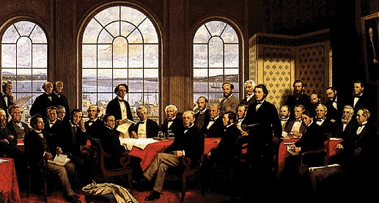
Quebec Conference (1864)

Slide 15
3. London Conference (Dec.1866)
4th step towards Confederation
But: Adopt the Costitution (England → Queen Victoria)
Discussions:
  Political system
  Protect the minority English population in Quebec
  ***BNA on July 1st, 1867***

Slide 16
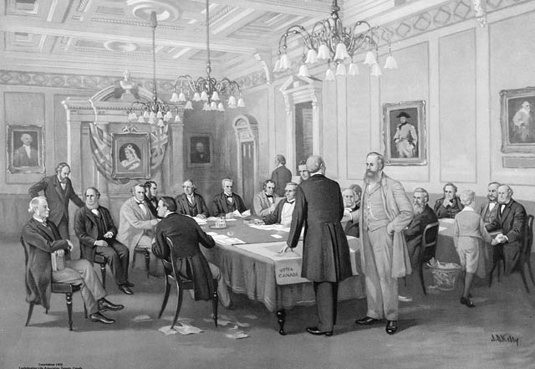
London Conference (Dec.1866)

Slide 17
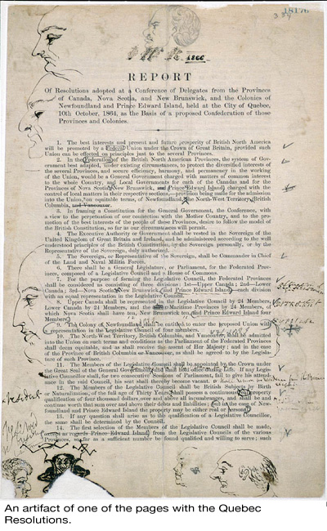
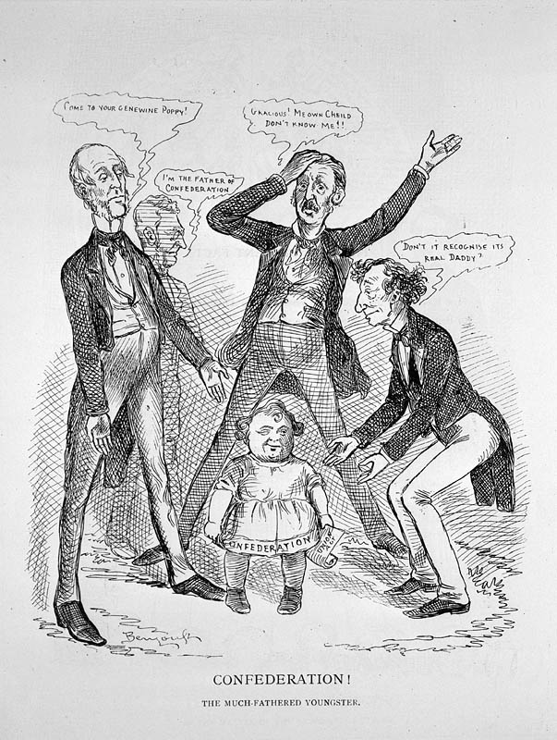

Slide 18
BNA in 1867 = Canada becomes independent?....
Not exactly…
Canada is a Dominion in 1867
The governor general represents the Queen in Canada
Canada still fights in British wars
Canada can’t sign international treaties
It cannot represent itself in other countries (no diplomats)
England can step in on any Canadian laws

Slide 19
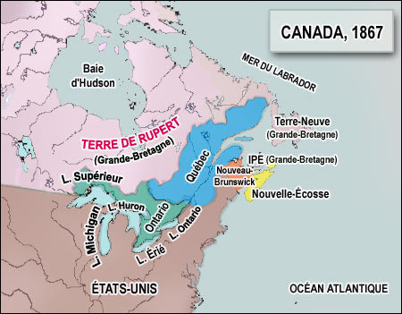
Canada in 1867: 4 Provinces
4 first provinces:
Ontario, Québec, New Brunswick, Nova Scotia
Colonies that did not join:
PEI
Noufoundland

Slide 20
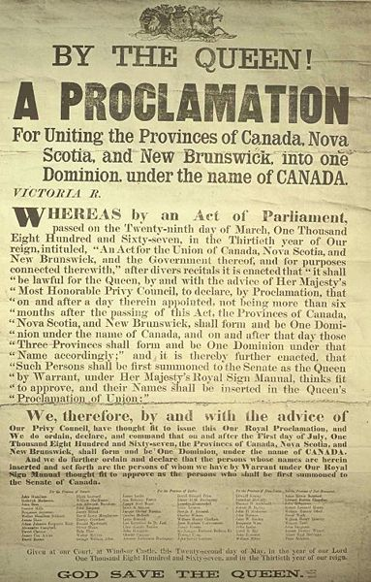
Ractions towards Confederation
Brittish Govt.
  Happy – they do not have to pay to defend Canada
maritimes:
  Some anti-confederation sentiments

