Slide 1
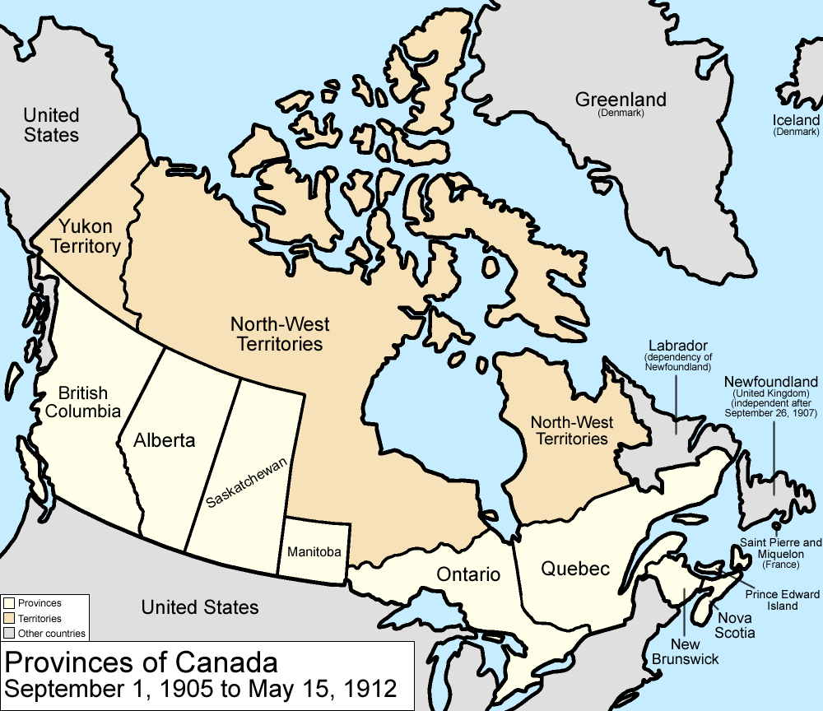
Prosperity and Nationalism in the early 1900s

Slide 2
Changes
John A. MacDonald took part in his last election in 1891 at age 76
Il e won the election in 1891→ but in 1891 → John A. MacDonald died
Between 1891-1896, the Consevatives (J.A.M.’s party)

Slide 3
Changes
In 1896, the Liberals lead by Sir Wilfred Laurier
The Liberals continued the Trif system to protect the Canadian companies
The Liberals were all about giving more power to the provinces → this was the opposite of the Conservative who wanted more federal power

Slide 4
R.I.P. Johnny Mac 1815-1891

Slide 5
Sir Wilfred Laurier (a.k.a. “Willy-L”)

Slide 6
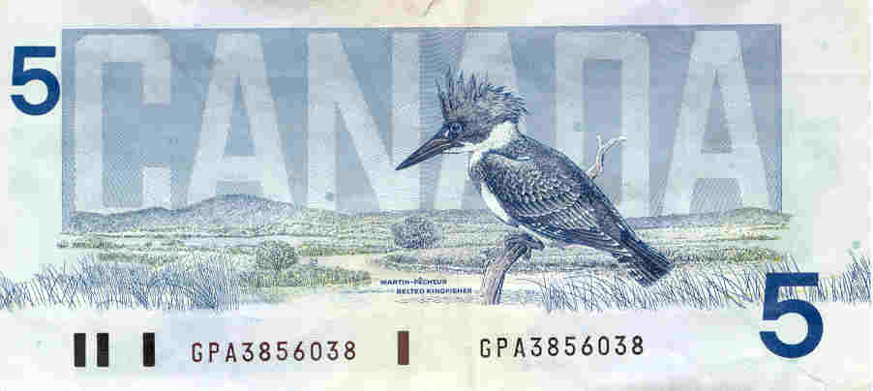

Slide 8
Global Prosperity
Lots of countries were doing well economically after 1900
England and the USA in particular
Canada was also doing well economically
However, Canada was still a dominion → not totally independent

Slide 9
Economic Power
England
Has a strong economy → wood, textiles, cotton, etc.
A colonial empire → British empire
Resources from places all over the world
Wood from Canada, spices from Asia, etc.
Competition from USA and Germany → other global powers

Slide 10
British Empire 1850

Slide 11
Some British colonies in 1880-1914

Slide 12
British Empire by 1910

Slide 15
England has many arms reaching to several colonies

Slide 16
Using India for tea

Slide 17
Canadian Stamp 1998 → showing as part of the Empire

Slide 18
Economic Power
United States
Industrial power
Large population
Producing lots of products making lots of $$$
Expansionism : Capital and technologie (Ford Motors)

Slide 19
Economic Power
Canada
Expnsion towards the West: « wheat boom » farming
Minister of the interior Clifford Sifton →Raise the population 3 million immigrants (1900-1911)
More railways→ ‘Grand Trunk’ Pacific and ‘Canadian Northern’ become government owned railways in 1917 and becomes “Canadian National”
Rise in industry in Central Canada (Ontario and Québec factories)

