Slide 1
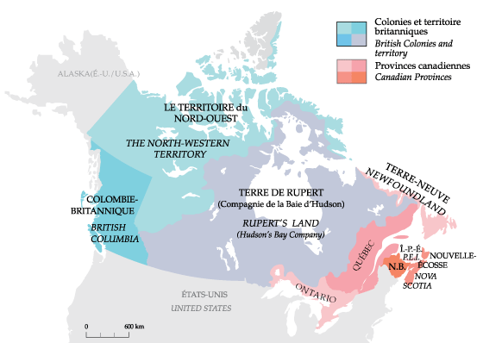
Quebec and Canada right after Confederation

Slide 2
Expansion of Territory
1870:
Canada demands the purchase of the land West of Ontario
They purchase the land for 1.5 million dollars
The land is called the « North West Territories »

Slide 4
Other provinces and territories join Canada
1870: Manitoba is created… Much smaller than it is now
1871: British Columbia joins Canada under the promise of a railway that connects it to the Eastern parts of the country
1873: PEI joins Canada
*** Because of this expansion, an American « invasion » is no more

Slide 5
Other provinces and territories join Canada
1897: Yukon is formed because of the gold rush
Because of minig towns that popped up, Canada needed to make Yukon a territory
RCMP

Slide 17
Economic Problems 1870s-1890s
&
The National Policy

Slide 18
Economic Crisis in Canada
Crisis in Europe→ Crisis in North America
Recessions all over the world
Canada → 4 recessions between 1873-1896
Problems in Canada:
demande for Canadian goods / products
No $$$ invested in Canada
High interest rates → difficult to invest in companies

Slide 19
Results of the recessions
Weak market for Canadian goods (Canadian goods are not being bought)
Companies make too many goods (surplus)
Companies have to sell for less = less profit
Less profit = less money to pay workers = less jobs
Canadians all over Canada are unhappy and the government gets less money from taxes

Slide 20
The National Policy (NP)
NP → started by John A. Macdonald and his government in power
Goal of the NP → try to solve the economic problems and unite the Canadian provinces
3 main points of NP:
Protect Canadian companies against foreign companies
Increase the number of railway lines from East to West
Increase immigration to Canada

Slide 21
Protect Canadian Industries
Increase Tarifs (taxes) placed on foreign products (USA, etc.)
Reduce competition from foreign companies
Increase Canadian production
Tarif money → Used to build infrastructure → railroads!

Slide 24
Build a stronger railway network
Build a transcontinental railway (« Canadian Pacific Railway ») → finished in 1885
Use the railway to transport raw materials, goods and people
Transport new immigrants to Western Canada (settlers) to the Western plains

Slide 25
Railway station near present day Calgary

Slide 26
Last spike in the Transcontinental Railway

Slide 27
Railway Workers

Slide 28
Banff Springs Hotel → Banff Alberta → Built by the railway company

Slide 29
Chinese immigrants used as labour to build the railway → they were not treated nicely

Slide 30
Chinese immigrant rail-workers camp

Slide 31
Chinese immigrant rail-workers camp

Slide 32
IMMIGRATION TO CANADA
Encourage immigrants to come to Canada
Canada wanted immigrants from Europe / United States
1.5 million immigrants between 1871-1901
Settled mainly in Western Canada
More immigrants meant more people to pay taxes and buy Canadian products

Slide 33
Immigrants from Eastern Europe arriving in Western Canada

Slide 34
Impact of the National Policy (NP) on Quebec

Slide 35
AGRICULTURE in Quebec 1870s-1890s
Problems
Not enough fertile land for farmers
Farming techniques that were not efficient
Farmers were sometimes not able to produce enough, even for their families

Slide 36
AGRICULTURE
NP in Québec
Agriculture:
changes
Wheat → Dairy production and other types of crops
Oats, potatoes, tobacco
Modernization
ex. : Teaching farmers new techniques, schools for farming

Slide 37
Population of Québec & emigration→1871-1901
Pop. of Québec in 1871→ 1.2 million
Pop. of Québec in 1901 → 1.65 million
Augmentation of 38 %
Within the same years for the rest of Canada → augmentation of 49%
Why such a difference between Quebec and the rest of Canada?
Birth rate? No. Québec had an elevated birth rate between 1871-1901…

Slide 38
Population of Québec & emigration→1871-1901
EMIGRATION? Yes!!!
emigration= leaving the place you live (country, province, region) for a short or long period of time → different reasons like war, lack of work food, etc.
Lots of French Canadians left Quebec between 1870-1890 for the United States (New England→ Maine/Massachusetts/ New Hampshire)
Why?
Lack of work → on farms especially / lack of fertile soil and land → can’t make a profit

Slide 39
Population leaving Québec: 1871-1930
Number of people | Destination
930, 000 | United States
70, 000-80,000 | Ontario
25, 000 | Western Canada

Slide 41
Farmer from Quebec leaving for the United states

Slide 42
Population of Québec & emigration→1871-1901
Lots of French Canadians ended up working in factories in the United States
Lots of people living in the New England region now can trace their ancestors to immigrants from Quebec

Slide 43
Population of Québec & emigration→1871-1901
Soulutions to stop emmigration?
Colonization in the late 1800s→ develop new ares where people an practice agriculture.
Groups promoting this → Catholic Church / Government of Québec
Catholic church thought that the people needed to « be close to th earth and nature » (agriculturalism)
5 developed regions → Laurentians, Témiscamingue/Outaouais, Lac St. Jean, Mauricie/ Bas St. Laurent & Gaspésie

Slide 44
Témiscamingue/
Outaouais
Laurentians
Lac St. Jean
Mauricie/ Bas
St. Laurent
Gaspésie
Railways

Slide 52
Population of Québec & emigration→1871-1901
How did people get to these new regions?
New railway lines:
Connect these regions with cities (Montréal, Québec, Sherbrooke, Trois Rivières)
Northern line → Connections between Montréal, St. Jérôme and the Laurentians
Did the plan to start new regions for colinization work?
No. The soils was too sandy, not great for agriculture / temperatures were too cold…

Slide 54
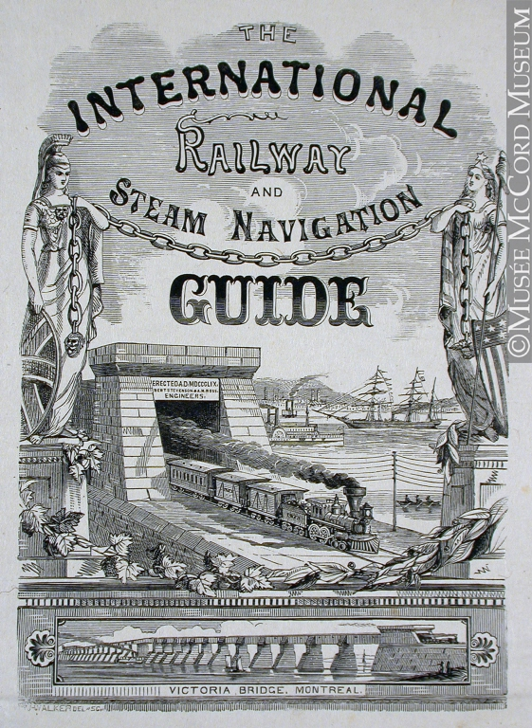

Slide 55
Living Conditions in Cities → early 1900s
Farms overpopulated in the early 1900s
Farming technologies improving mean less people needed to work on farms
These factors = people migrate towards cities
Cities= jobs

Slide 56
Living Conditions in Cities → early 1900s
Montréal → Financial center of Canada
Big companies → head offices in MTL
Big companies = jobs = workers = MTL’s population rises quickly
1931 = population of 1 million in MTL

Slide 57
Population of Cities in 1901 and 1931 → Province of Quebec
 | 1901 | 1931
Montréal and surounding areas | 324,880 | 1, 023, 158
Quebec City | 68, 840 | 130, 594
Sherbrooke | 1, 765 | 28, 933
Trois-Rivieres | 9, 981 | 35, 450
Hull | 13, 993 | 24, 433

Slide 58
Living Conditions in Cities → early 1900s
MTL in 1930 = 60% francophone
However, most of the advertisments and signs in MTL are English

Slide 59
Living Conditions in Cities → early 1900s
After 1900 → in cities:
Wealthy and poor
New Technologies
New Services → ‘streetcars’, parks, etc.
Time for leisure (parks, sports, cinemas, nightclubs, etc.)
Media (newspapaer, radio → CKAC)
Big stores (Eatons, Ogilvy’s, etc.)

Slide 60
Port of MTL-1920s

Slide 61
Boul. St Laurent - 1921

Slide 62
Sun Life Building-1930s

Slide 64
CKAC RADIO-1920s

Slide 71
Living Conditions in Cities → early 1900s
Prosperity and Poverty in MTL:
Wealthy people (English) = Upper class neighboroods = secure, good sewer systems, good water quality, electrcity, streets lined with trees
Men with good jobs→ $3500 per year. NO manual labour
Wealthy neighborhoods→ Westmount/Golden Square Mile/Outremont
Wealthy neighborhoods seperated from factories and on top of Mount Royal

Slide 72
Living Conditions in Cities → early 1900s
Lower class (poor) people (French & immigrants) = lower class neighborhoods = not good sewer systems & poor quality water / no electricity /no security/ small houses / narrow streets
Lower class / working class men→ $1000 per year
Non paturized milk → bad for children to drink
Consequences of these conditions :
Infant mortality rate very high
Epidemics
tuberculosis

Slide 73
Living Conditions in Cities → early 1900s
Children → 1 in 3 die before 1st birthday
Minimal job security
Lower class neighborhoods→ St. Henri/Griffintown/ Petite Bourgogne → close to factories
Money spent on food, shelter and clothing→ no money for fun

Slide 74
Golden Square Mile -1920s

Slide 75
Golden Square Mile
1918
Now
Corner Guy and Sherbrooke

Slide 76
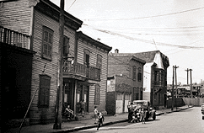
St-Henri – 1920s

Slide 77
St Henri Lachine Canal

Slide 78
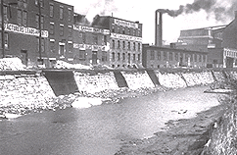
St Henri –Canal Lachine
1920s
Now

Slide 79
Living Conditions in Cities → early 1900s
Working Conditions in factories:
Difficiles dans les manufactures
Aucune protection pour l’ouvrier
Salaires et traitements tellement bas qu'ils forcent souvent tous les membres de la famille à travailler

