Slide 1
Influence of the Catholic Church: 1850-1901
Lots of religious leaders in the Catholic church believed that the church should hold more power than the Government Montréal → Évêque Ignace Bourget (dirigeant a Montréal)
This current of thought (idea) is called ULTRAMONTANISM
The church still held a lot of power within Quebec in the late 1800s-early 1900s:
Record keeping → marriage, death, birth
In charge of Catholic education (elementary / seconday schools, « classical colleges », Université de Laval)
In charge of several charities
Influence of how people behaved within society

Slide 2
Protestant, Judaism, Orthodox Christians
The Protestant church help a lot of people in Montreal → schooling, charity, etc.
However, it did not hold the same influence as the Catholic church did on society
Montréal: A visable presence of synagogues and Orthodox Christian churches

Slide 3
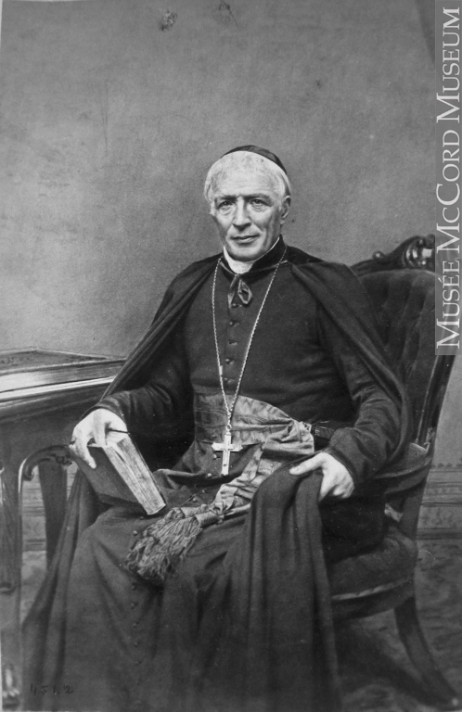

Slide 4
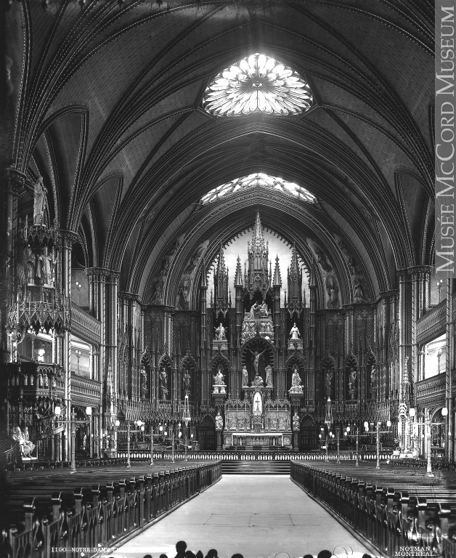

Slide 5
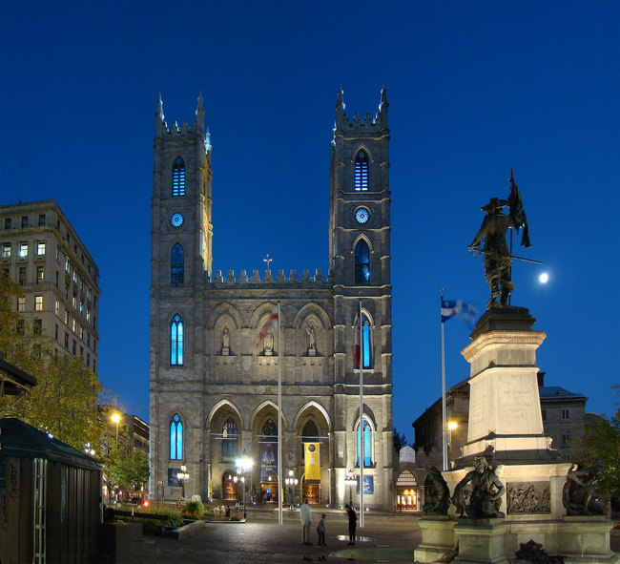

Slide 6
