Slide 1
First Encounters between First Occupants and Europeans
The first major encounters between the First Occupants and Europeans → 1500s
The First Occupants were introduced to European lifestyles
This changed their lives forever!!!

Slide 2
Fish brought the Europeans to the shores of North America
France, Spain, Portugal and Italy were interested in fishing
No red meat eaten on Fridays (Catholicism)
Fish eaten instead!
Need for Fish + lots of COD in GSL = fishing
Fishing grounds in the GSL

Slide 3
Gulf of St. Lawrence

Slide 4
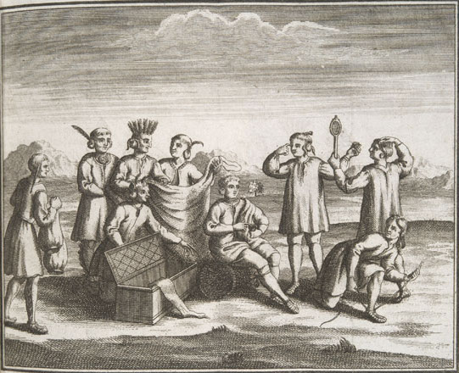
The First Contacts: Economic Changes
European fishermen were some of the first Europeans to encounter first Occupants
Along the shores of the GSL while fishing
Both Europeans and the First Occupants introduced each other to different goods
They began to trade with one another

Slide 5
Some changes…
The First Occupants were interested in European goods
They were interested in:
metal tools,
small items like toys
glass
brass pots and pans
WHY? They did not have any of these goods

Slide 6
Europeans also introduced….
Food → vegetables such as onions were introduced to the First Occupants
‘orchards’ to grow fruit
Domesticating animals were also introduced.
GUNS!
Alcohol
Types of clothing were also introduced to the FO → cotton and wool

Slide 8
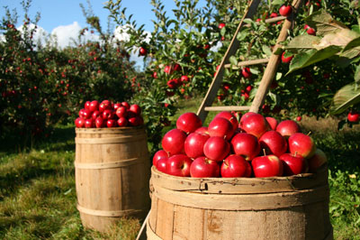

Slide 9
What did Europeans get?
While trading- Europeans became interested in the furs that the First Occupants had
Furs became a main item in trades between the FO and Europeans

