Slide 1
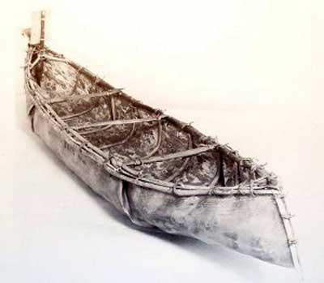
ECONOMY & DEVELOPMENT The First Occupants: Subsistence & Trade

Slide 2
Main Questions:
What is SUBSTINENCE and how does it relate to the First Occupants?
How did the different First Occupant groups ADDAPT to the regions they lived in?
Was there a DIVISION OF LABOUR between men and women in the different First Occupant groups?
What is barter? How did the First Occupants use BARTER and why was BARTER important?

Slide 3
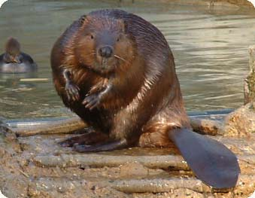
Subsistence: What you need to SURVIVE
Each First Occupant group (Iroquoian, Algonquian and Inuit) adapted their lifestyle to where they lived
They made tools and modes of transportation to suit their needs
They produced food or hunted for food depending on where they lived
The first occupants relied on NATURAL RESOURCES to survive → NOT FOR PROFIT

Slide 4
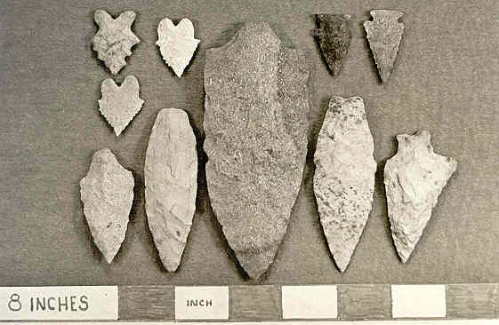
The First Occupants & Adaptation
Where a group lived = how they adapted
Food
Shelter
Transportation
Production (tools, etc.)
Did each group have their own ways of adapting? YES!

Slide 5
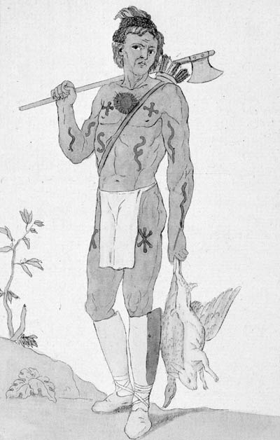
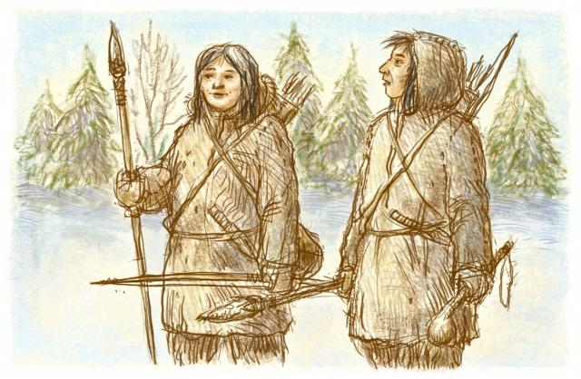
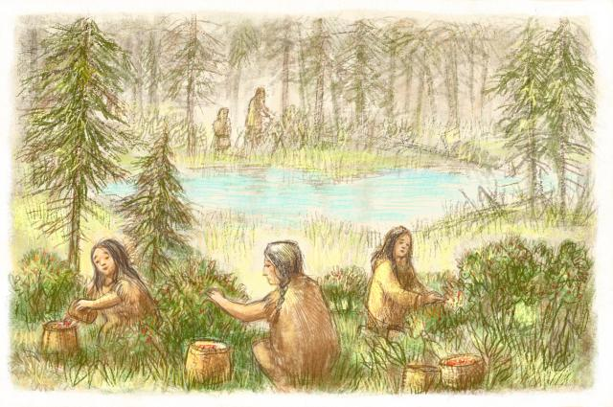
Food & Materials
Algonquians = Canadian Shield = NOMADIC
Hunting big/small animals
Gathering Vegetation (berries, etc.)
Hunting birds
Fishing
Wolf or beaver → used for clothing
Hunting meant small groups of people that only needed small camps-NOT VILLAGES

Slide 6
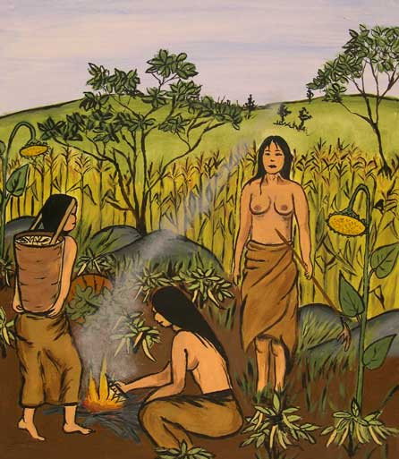
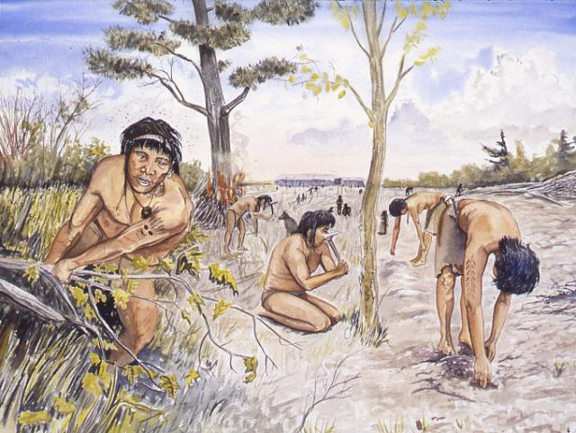
Food & Materials
Iroquoians = St. Lawrence Valley & Great Lakes = SEDENTARY
Agriculture
Corn and other veggies
‘slash and burn’ method for crops
DID NOT rely on hunting as much as the Algonquians
FIELDS WERE SET UP CLOSE TO THE VILLAGE FOR GROWING CROPS

Slide 7
Algonquians & Labour
Women
Gather food
Fishing and hunting small animals
Crafts
Care/education of kids
Men
Hunt & fish
‘Heavy’ work
Trade
War

Slide 8
Iroquoians & Labour
Women
Agriculture
Gather food
Cooking/Cleaning
Crafts
Care/education of kids
Men
Clear land
Construction
Seasonal hunting/fishing
Making tools/weapons
Trade
War/diplomatic duties

Slide 9
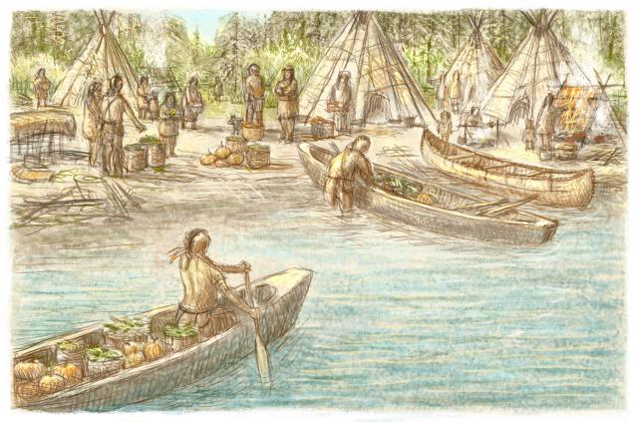
Trade & Barter
Living in different regions → different resources available
Some tribes did not have access to certain things
Groups used SURPLUS to trade with other tribes to get what was needed

Slide 10
Iroquoian Tribes:
- Surplus of agricultural goods
- But they need furs and meat
-Trade Surplus of agricultural goods for furs/meat
Algonquian Tribes:
- Surplus of furs/meat
-In need of corn
-Trade Surplus of furs/meat for corn

Slide 11
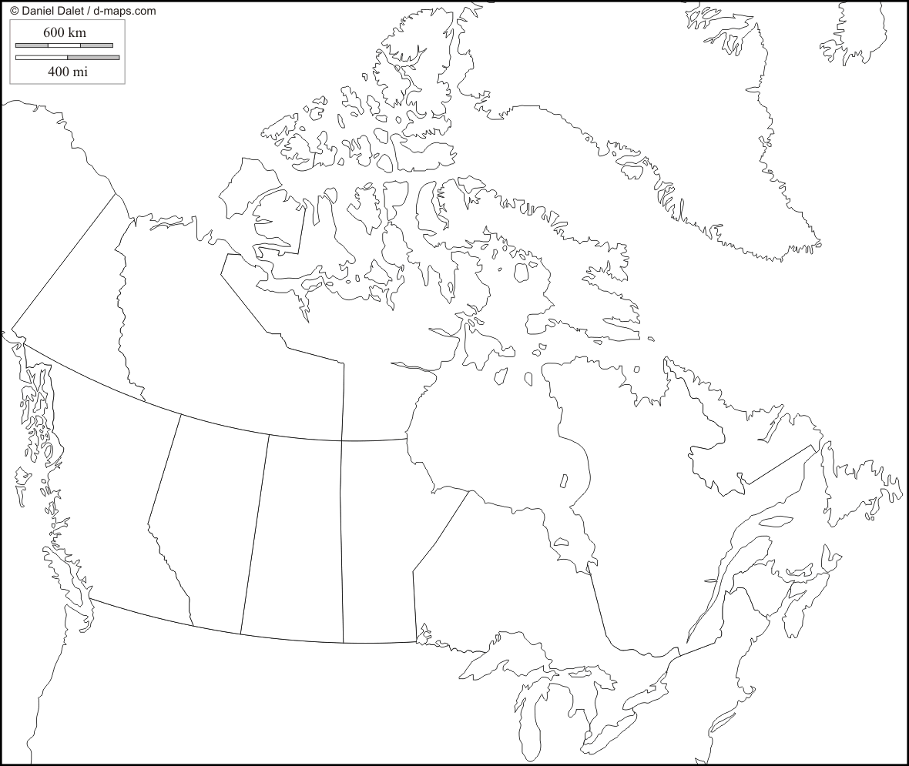
First Occupants: Trade networks
Each group lived in a different area → specialized in certain ‘goods’ (vegetables, furs, stones beads, etc.)
Groups travelled and met up with each other to TRADE.
Movement of Shells
Finish
Start

Slide 12
First Occupants: Trade networks
Goods were passed along and could go from one end of North America to another, going from one person to another to another.
Meeting places for trade were along WATERWAYS (rivers, lakes)
This was called:
A TRADE NETWORK
Movement of Shells
Finish
Start

Slide 13
First Occupants: Trade networks
Movement of Shells
Finish
Start

Slide 14
Significance of Trade for the First Occupants
Why was trade important for the First Occupant groups??
Satisfy basic needs (food, clothing, etc.)
Demonstrate generosity
Diplomatic reasons: show good faith between groups (peace negotiations, trade during important meetings, etc.)

