Slide 1
The Province of Quebec transforms again!

Slide 2
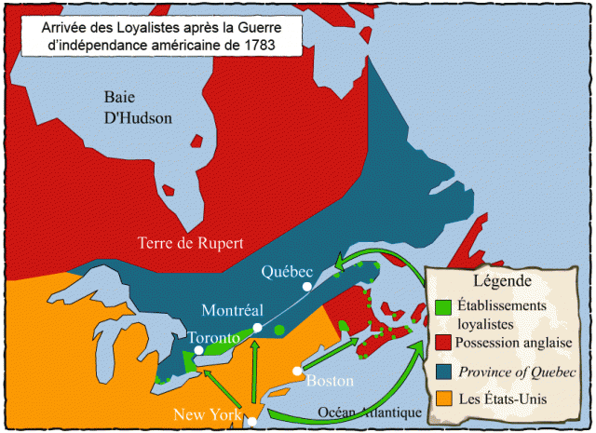
Arrival of the Loyalists after the American Revolution
Legend
Loyalist
Settlements
English Territory
United States

Slide 3
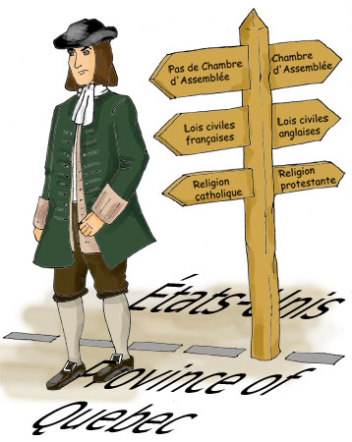
Constitutional Act 1791: Territory and Government
Changes in the P.O.Q. after the Loyalists arrive
Why?
They wanted to have a more « English » society rather than living in a « French » territory

Slide 4
Constitutional Act 1791: Territory and Government
Constitutional Act 1791
Divides the territory into 2 regions
Lower Canada is East of the Ottawa River
Upper Canada is West of the Ottawa River
The Loyalists FINALLY have their own territory → Upper Canada

Slide 5
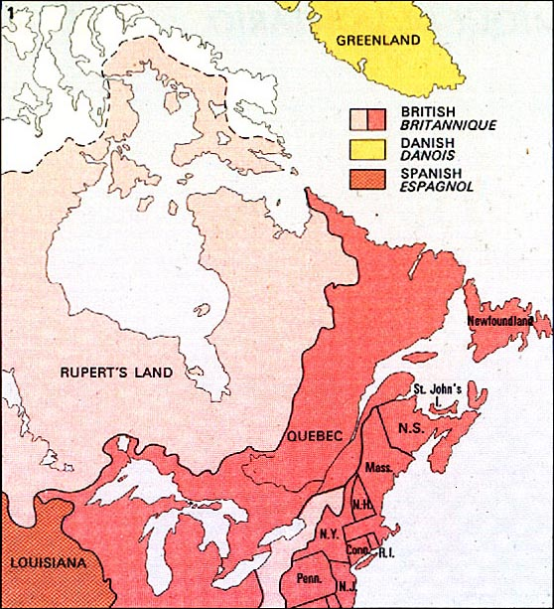
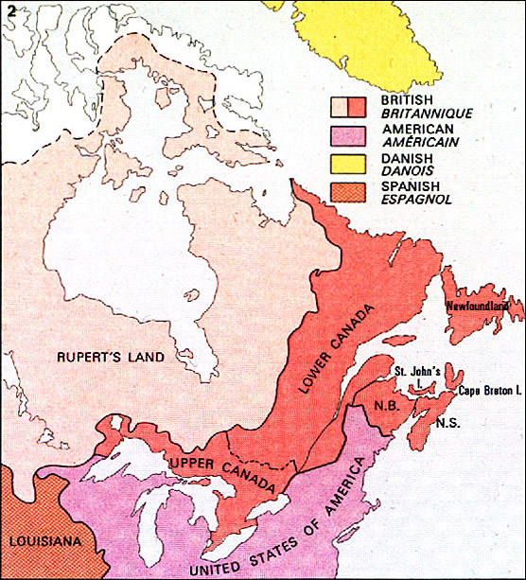
Constitutional Act 1791
Before 1791
After 1791

Slide 6
Lower Canada = Predominantly French, Catholic
Upper Canada =
Predominantly
English and Protestant

