Slide 1
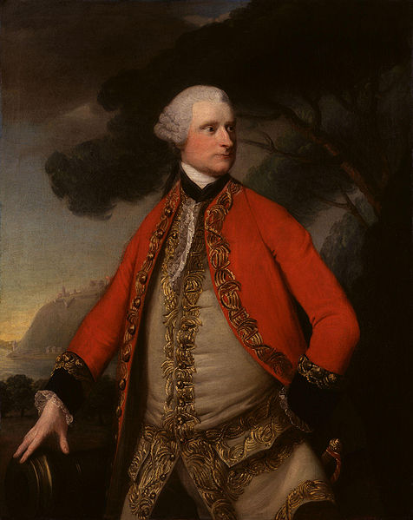
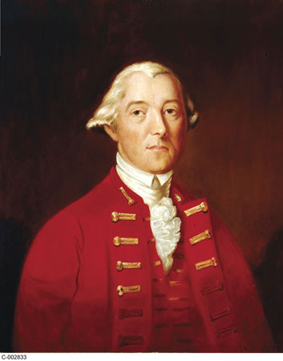
Murray and Carleton’s political and social policies
James Murray
Guy Carleton

Slide 2
James Murray
First governor of the Prov. Of Quebec → 1763
In charge of a lot of French speaking Catholics
Difficult task
Murray understood that the Royal Proclamation would be a big problem in the Prov. Of Quebec.
Why?

Slide 3
Conciliatory policies by the first governors
Contexte Social :
The Canadiens lost all of the elites and government…
They are still the majority of the population
The “Montrealers” (English) replace the French Elites (wealthy)
CONTEXTE POLITIQUE:
The 13 colonies are unhappy
The Canadiens listen to the Catholic Church and remain calm
The Montrealers want to control politics with the Prov. Of Quebec

Slide 4
Conciliatory policies by the first governors
CONCLUSION:
The British governors compromise… Religion and language compromises
French majority in P.O.Q
British willing to compromise with the French in the P.O.Q.
Unhappy 13 colonies

Slide 5
Conciliatory Policies
MURRAY 1763
Political: Names councillors that sympathize with the French
Religion: Bring back Bishop into P.O.Q.
Justice: No oath of allegiance
CARLETON 1766
Politique : Names Canadiens to the council
Religion: Recognizes clergy → abolishes Oath of allegiance
Justice: Brings back French Civil laws

Slide 6
Reactions to the Policies :
Varied English reaction:
French Party : happy for the French
British Party : against the compromises
Canadiens:
Leaders are happy (wealthy merchants, seigneurs and church)
General public → not super happy but no revolt

