Slide 1
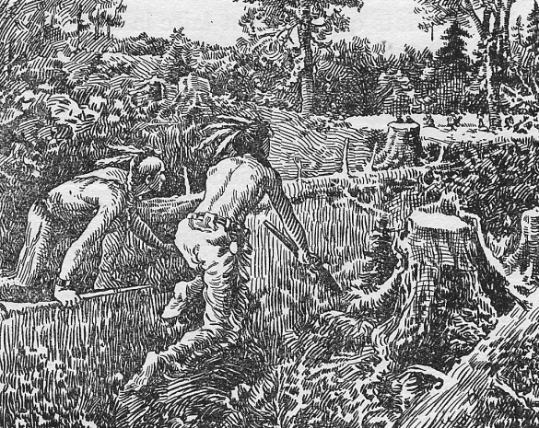
First Occupants & Culture

Slide 2
Quebec around the year 1500
What was Quebec like around the year 1500?
Occupied by several Aboriginal groups
The culture was closely linked to the environment.
Aboriginal people depended on the environment in order to survive. What do you think this means?
Social relationships between the aboriginal people were influenced by the personal qualities they valued in people.
Aboriginal spirituality focused on ‘Animism’

Slide 3
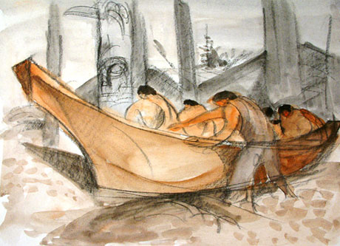
Aboriginal groups in 1500
There were three major aboriginal language groups: Inuktitut, Algonquian and Iroquoian.
Several ‘sub groups’ were included in each language group.

Slide 4
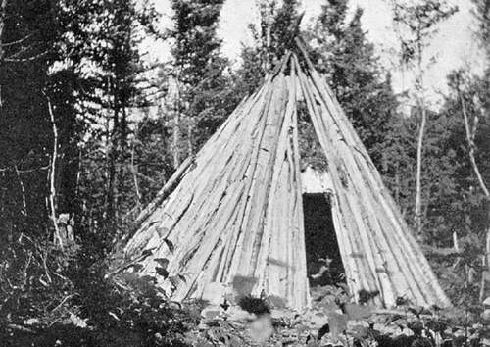
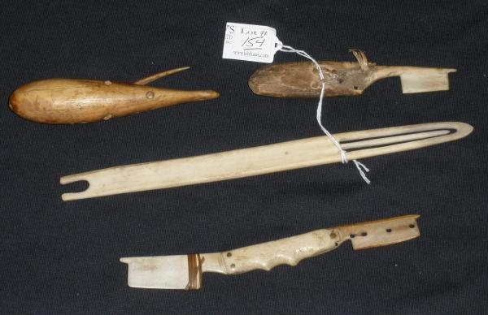
Culture and the Environment around the year 1500
Aboriginal people had lots of respect for the natural environment →
environment way to survive
Food, shelter, transportation, tools, etc. → provided by natural environment

Slide 5
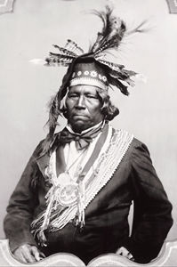
Social Relationships Around the Year 1500
Being important (ex: a chief) within a group like the Iroquoians, depended on their own personal qualities.
In the aboriginal peoples’ culture, certain qualities were valued over others.
Some important qualities included: good speaking abilities ,‘warrior qualities’ and generosity .

Slide 6
Reciprocal Relationships
What does this mean?
To put it simply, it means ‘mutual respect’. To have respect for one another and to show that through actions.
How did this show up in the aboriginal peoples’ culture?
A good example could include food. When food was scarce, it was shared as evenly as possible.

Slide 7
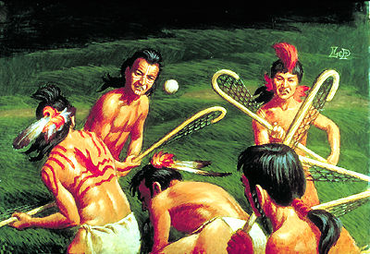
Aboriginal Sports & Games for the first Occupants

Slide 8
Spirituality: Animism
Aboriginal people were ‘Animists’, which meant that they believed that animate objects (like animals and people) as well as inanimate objects (like tools) had spirits.
These spirits could exist outside of the object. For example, a deer’s spirit could live on after the deer had died.

Slide 9
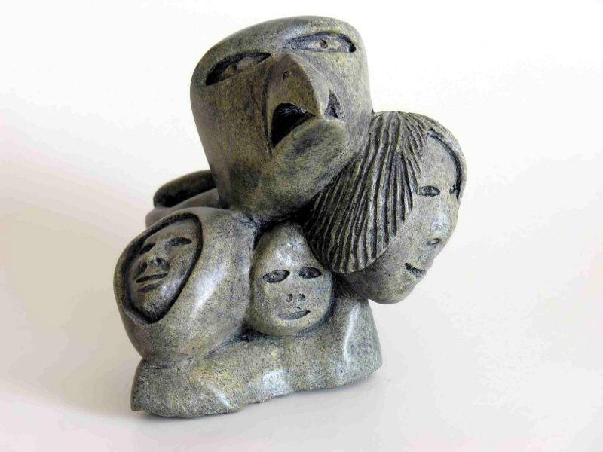
Animism & the First Occupants
Culture and Spirituality of the first occupants → both linked to the natural environment
Animism valued the respect for the natural environment (plants, animals, etc.)

Slide 10
Spiritual ‘Leaders’
Shamans:
Predict Future
Interpret dreams
Clairvoyant
Wasn't considered ‘better’
Elders:
Older individuals
‘Wiser’/experience
Advice given

Slide 11
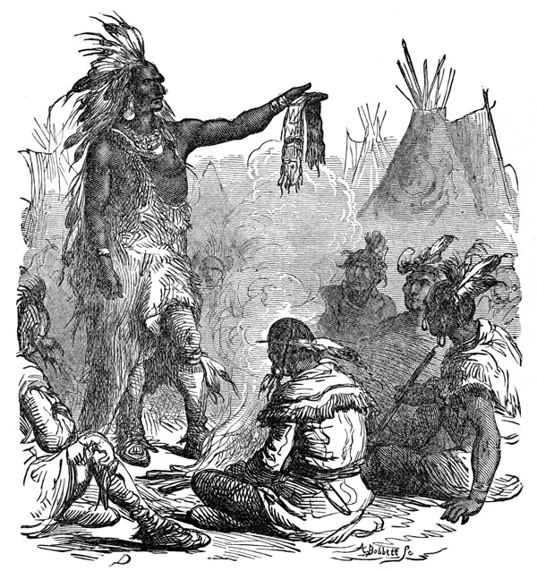
Cultural Expression
Animism and other elements of First Occupant culture were expressed through:
Art like amulets/ totem poles, etc.
Verbal expression like story telling/singing
Story telling very important for passing on culture

